Slide 1
INTRODUCTION
A.R. Hurson

Slide 2
Introduction
  Computer: A device that stores and retrieves data and sequentially (mainly) executes a stored program without human intervention.
  A computer, like any other system, is a collection of entities (components) interconnected in order to perform a well defined function. This function is determined by the functions performed by its components and by the manner in which they are interconnected.
  The function of the computer is a mapping of the input data to the output data:
F: A → B
  In case of a digital system A and B are digital or discrete quantities.
A.R. Hurson

Slide 3
Introduction
  The study of computers is the study of its components, their interactions and their parallel activities and co-operations.
  In this module a computer is viewed as a collection of five interconnected components:
    Input Unit
    Output Unit
    Memory Unit
    Central Processing Unit (CPU):
      Control Unit (CU)
      Arithmetic Logic Unit (ALU)
A.R. Hurson

Slide 4
Introduction
  Input Unit: is an interface between the outside world and the internal parts. It performs two tasks: Transmission and Translation of information.
  Output Unit: is an interface between the internal parts and the outside world. Its functions are the same as the Input Unit.
  Memory Unit: acts as storage. It stores the instructions, data, intermediate, and final results.
  Central Processor Unit: is used to:
    Interpret the instructions and initiate their executions.
    Perform arithmetic and logical operations on the data.
A.R. Hurson

Slide 5
Introduction
CPU
CU
ALU
Information
Result
Input Unit
Memory Unit
Output Unit
Data Path
Control Path
A.R. Hurson

Slide 6
Introduction
  In general, a computer can be studied at four different levels: Electronic, Logic, Programming, and System. Though it is hard to generalize, usually:
    Electronic level is the subject of physics, mathematics, and electrical engineering
    Logic level is the subject of electrical engineering and computer engineering, and
    Programming and System levels are the subjects of computer science and engineering.
A.R. Hurson

Slide 7
Background Module1
Level | Components
Electronic | Active: transistor, voltage sources Passive: resistor, capacitor
Logic combinational sequential register | gates, AND, OR, ... Flip Flops, ... • register, data, operators, ...
Programming compiler interpreter machine oriented assembly machine micro • • •
System | control, processor, ...
A.R. Hurson

Slide 8
  Introduction
    A digital system can be viewed as a combinational and/or sequential device. Therefore, it can be evaluated at the combinational and/or sequential sublevels.
    Similarly, a computer system can be studied in terms of the functions it could handle. This is the basis for Logic Transfer Level.
    At Logic Transfer Level, one requires a set of notations (language) to carry out such evaluation. This method is called Register Transfer Logic and the language is called Register Transfer Language.
A.R. Hurson

Slide 9
Introduction
  We take a top-down approach to study a complex object.
    A complex object is recursively broken down into its components.
    At each level, we study the components and the inter-actions among them.
  In Computer science and engineering a computer will be studied at Logic, Programming, and System levels.
  We will try to define a set of notations and rules in order to be able to study and analyze a computer.
A.R. Hurson

Slide 10
Introduction
  Computer: A device capable of solving problems (data manipulation) by accepting data, performing prescribed operations on the data, and supplying the results.
  Microprocessor: a computer that is contained in a single integrated circuit (all peripherals are off the CPU chip).
  Microcontroller: A microprocessor with a number of integrated peripherals, typically used in control-oriented applications (everything is on one chip).
  Central processing unit: The component of a computer system with the capability to control the interpretation and execution of the instructions. The CPU includes the arithmetic-logic unit and the control unit.
A.R. Hurson

Slide 11
Introduction
  Primary Memory: Also called Main memory. It is a volatile/nonvolatile memory that holds the program and intermediate data during the course of a program execution.
  Secondary Memory: A nonvolatile memory that is used to hold the program and data between the runs.
A.R. Hurson

Slide 12
Introduction
  Assembly Language: A symbolic representation of machine language.
  Assembler: A compiler that translates assembly language to machine language.
  Translation: To change information from one form of representation to another without changing the meaning.
  μ operation: A basic operation that is executed during a clock cycle.
A.R. Hurson

Slide 13
Introduction
  Transmission: The act of sending information from one location and the receiving of the same information in another location.
  Logic Transfer Level: A method in which a computer is studied based on its functionality.
  Register Transfer Language: A tool which allows to represent, study, and analyze a computer at the Logic Transfer Level.
A.R. Hurson

Slide 14
Some Facts
  Processor
    Logic capacity: increases about 30% per year
    Performance: 2x every 1.5 years
  Memory
    DRAM capacity: 4x every 3 years
    Memory speed: 1.5x every 10 years
    Cost per bit: decreases about 25% per year
  Disk
    Capacity: increases about 60% per year
A.R. Hurson

Slide 15
Questions
  Why are we interested in computer?
  what is the distinction between program and data?
  What is a machine dependent language?
  What is the difference between machine dependent and machine independent languages?
  What is the difference between assembly instruction and machine instruction?
  What is the difference between the assembly instruction and the micro instruction?
A.R. Hurson

Slide 16
Questions
  Define the term “Little Endian”.
  Define the term “Big Endian”.
  Define the term “Instruction Format”.
A.R. Hurson

Slide 17
Performance Measures
  We will make an attempt to introduce several performance metrics to evaluate the behavior of a computer.
  We are also interested to study the suitability of these performance metrics.
A.R. Hurson

Slide 18
Performance Measures
  Response Time (Execution time, Latency) — The time elapse between the start and the completion of an event.
  Throughput (Bandwidth) — The amount of work done in a given time.
  Performance — Number of events occurring per unit of time.
A.R. Hurson

Slide 19
Performance Measures
  Note execution time is the reciprocal of performance — lower execution time implies higher performance.
  Note Response time, Throughput, and Performance are all closely related to each other.
A.R. Hurson

Slide 20
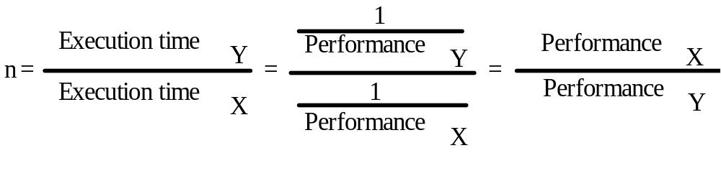
Performance Measures
  A system (X) is faster than (Y), if for a given task, the response time on X is lower than on Y.

Slide 21
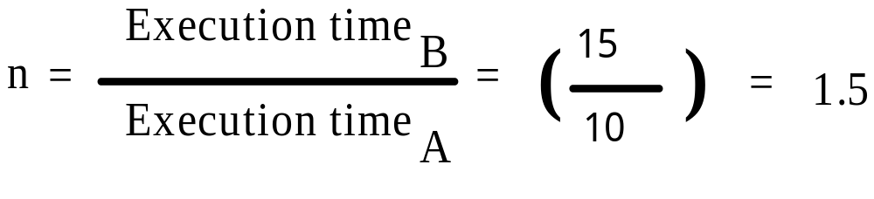
Performance Measures — Example
  Machine A runs a program in 10 seconds and machine B runs the same program in 15 seconds. Therefore:
A.R. Hurson

Slide 22
Performance Measures
  Response Time (Elapse time) — The latency to complete a task, including disk accesses, memory accesses, I/O activities, operating system overhead, ...
A.R. Hurson

Slide 23
Performance Measures
  CPU time — The time the CPU is computing. It is further divided into:
    User CPU time — The CPU time spent in the program,
    System CPU time — The CPU time spent in operating system performing tasks requested by the program.
A.R. Hurson

Slide 24
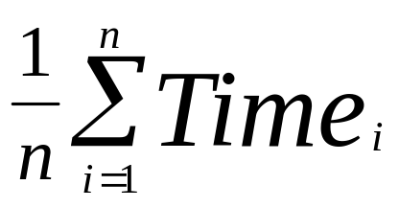
Performance Measures
  Average Execution time — Equal probability of running programs in the workload
Where Time_{i} is the execution time of the i^{th} program
And n is the number of the program in the workload.
A.R. Hurson

Slide 25
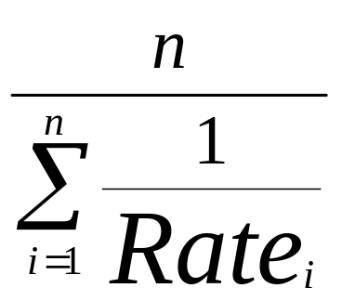
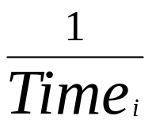
Performance Measures
  Consequently we can define Harmonic Mean as
where Rate_{i} is proportional to
A.R. Hurson

Slide 26
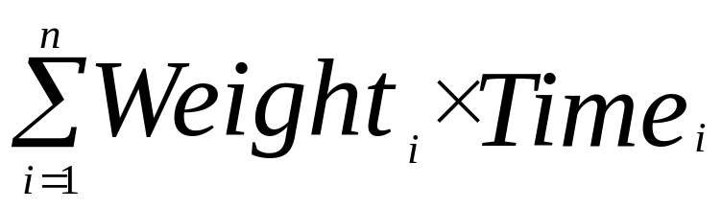
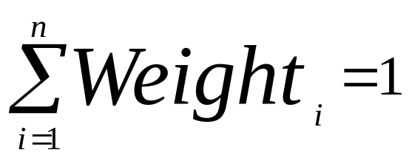
Performance Measures
  Weighted Execution time — unequal mix of programs in the workload
where weight_{i} is the frequency of the i^{th} program
in the workload.
Note
A.R. Hurson

Slide 27
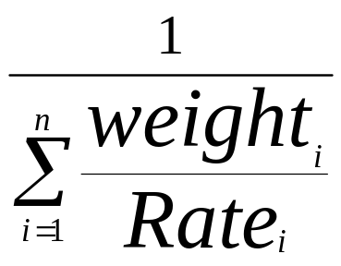
Performance Measures
  Similarly, weighted harmonic mean is defined as:
A.R. Hurson

Slide 28
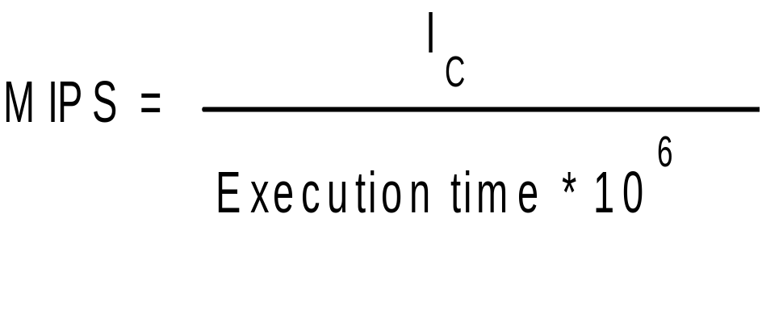
Background Module1
Performance Measures
  Million Instructions Per Second — MIPS is another performance measure to be used to evaluate computers.
  MIPS (meaningless Indication of Processor Speed)
A.R. Hurson

Slide 29
Background Module1
Performance Measures
  Million Floating Point Operations Per Second — MFLOPS is another performance measure to be used to evaluate computers.
Number of floating point operations in a program
MFLOPS =
Execution time * 10⁶
A.R. Hurson

Slide 30
Background Module1
Performance Measures
  Justify the following:
    MIPS depends on the instruction set. Thus, it is hard to compare computers with different instruction sets.
    MIPS depends on the instruction mix in a program.
    MIPS can vary inversely to performance.
A.R. Hurson

